Slide 1
MY DREAM JOB

Slide 2

COMPANY PROFILE HSBC is one of the world’s largest banking and financial services organisations. We serve approximately 40 million customers through our global businesses: Wealth and Personal Banking, Commercial Banking, and Global Banking & Markets. Our network covers 63 countries and territories in Europe, Asia, the Middle East and Africa, North America and Latin America. Our purpose – Opening up a world of opportunity – explains why we exist. We’re here to use our unique expertise, capabilities, breadth and perspectives to open up new kinds of opportunity for our customers. We’re bringing together the people, ideas and capital that nurture progress and growth, helping to create a better world – for our customers, our people, our investors, our communities and the planet we all share. Listed on the London, Hong Kong, New York and Bermuda stock exchanges, shares in HSBC Holdings plc are held by around 182,000 shareholders in 128 countries and territories.

Slide 3

MY DREAM JOB
WHEN I COMPLETED MY 12TH STD I HAD A KEEN INTREST IN FINANCE
WHEN I STARTED RESEARCHING ABOUT THIS IT WAS QUITE INTRESTING ABOUT MERGEERS AND ACQUISTIONS IPO’S ETC..
THEY ARE USUALLY DIVIDED INTO
TOP TIER
MIDDLE TIER
BOTTOM TIER

Slide 4


TOP 5 INVESTMENT BANKER
JP MORGAN
KOTAK MAHINDRA BANK LIMITED
YES BANK LTD
SBI CAPITAL MARKET
TATA INVESTMENT CORP LTD
REASONS WHY I AM SUITABLE FOR THIS
MY KNOWLEDGE IN THIS FIELD
HARDWORKING
WORKS TOWARDS THE GOAL
PUNCUTALITY

Slide 5
ROLES OF INVESTMENT BANKER
Capital Raising
Book Building
Initial Public Offerings (IPOs)
Issuing & Selling Securities
Private Placement of Capital
Mergers, Acquisitions & Divestitures
Corporate Restructuring
Debt & Equity Advisory Services
Bond Issuance & Pricing on Bond Markets
Hedge Fund, Mutual Fund, & Pension Fund Advisory Services

Slide 6
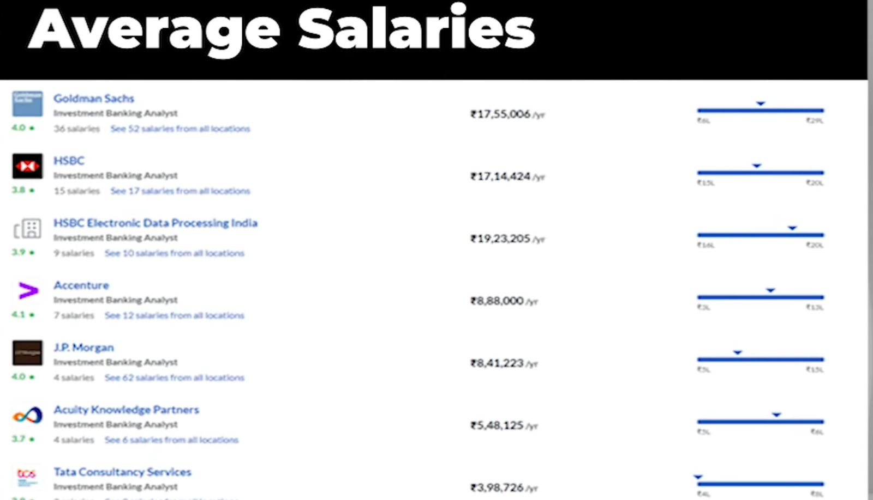

Slide 7
THANK YOU

